Slide 1

IOT based smart wearable safety gadget
Group-7
Ronakkumar Sharma(c0747019)

Slide 2
Interfacing of GSM with LPC2148

Slide 3
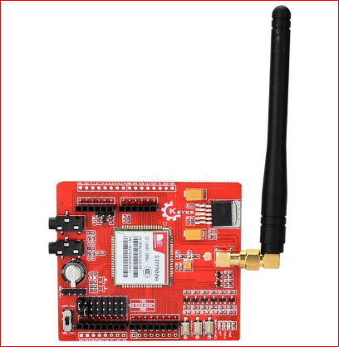
GSM
Mobile communication system.
Services- sending messages and making
calls.
Operating frequency bands – 850MHZ,900MHZ,1800MHZ,1900MHZ
Carry capacity -64kpbps-120Mbps
Work on AT commands.

Slide 4
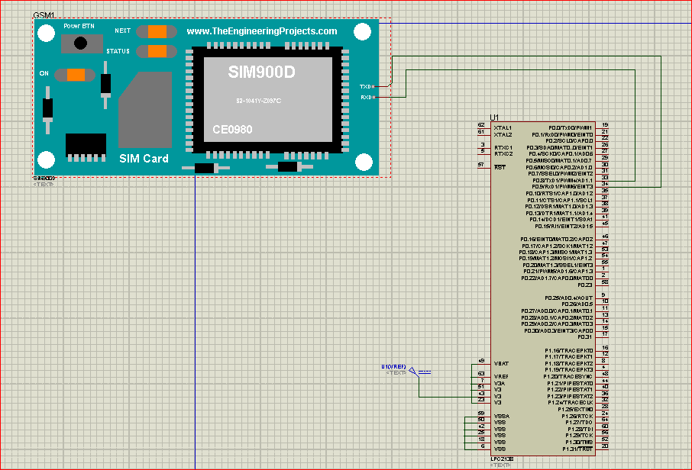
Schematic design

Slide 5
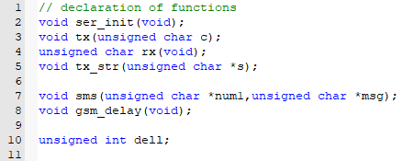
Coding(gsm.h file)

Slide 6
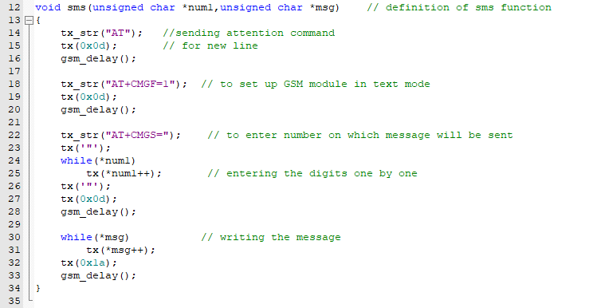
Continued…

Slide 7
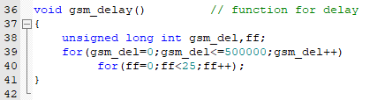
Continued…

Slide 8
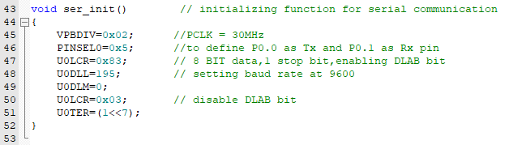
Continued….

Slide 9
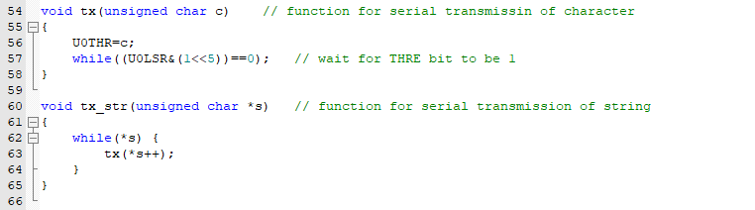
Continued…

Slide 10

Continued…

Slide 11
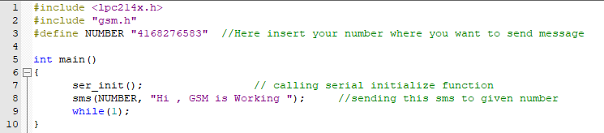
gsm.c file

Slide 12
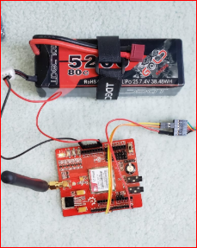
Hardware Implementation

Slide 13
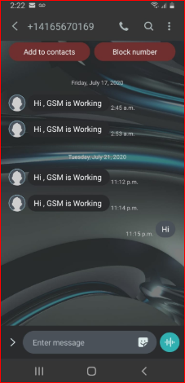
Results

Slide 14
Reference
Elprocus.(2020).GSM-Architecture,features,working. https://www.elprocus.com/gsm-architecture-features-working/
LPC2148 UART0 by electronicwings
https://www.electronicwings.com/arm7/lpc2148-uart0
EmbeTronicX-LPC2148-GSM Interfacing
https://embetronicx.com/tutorials/microcontrollers/lpc2148/gsm-interfacing-with-lpc2148/

